Slide 1
COHORT EFFECTS
& changing distributions
Adam Hulmán (LEAD member)
Department of Medical Physics and Informatics
University of Szeged, Hungary
LEAD 2014
e-mail: hulman.adam@med.u-szeged.hu

Slide 2
Cohort effect (definition)
“Variation in health status that arises from the different causal factors to which each birth cohort in the population is exposed as the environment and society change. Each consecutive birth cohort is exposed to a unique environment that coincides with its life span.” (Dictionary of Epidemiology)
“period and age effects interact to create cohort effects” (Keyes et al., Soc Sci Med 2010;70:1100-1108)

Slide 3
Problem definition
Longitudinal dataset
Continuous outcome
Explanatory variables (continuous!)
  Age
  Year of birth (YOB)
  Calendar year (CY)
How to analyze change over time?
Linear dependence!
Notes:
Mention age…

Slide 4
Aim (1)
To assess age-related trajectories and to investigate cohort effects simultaneously

Slide 5
Study population
Whitehall II study
10,308 participants (67% men)
1985-2009
Clinical examination every 5 years
Up to 5 measurements within individuals
Outcomes: cardiovascular risk factors

Slide 6
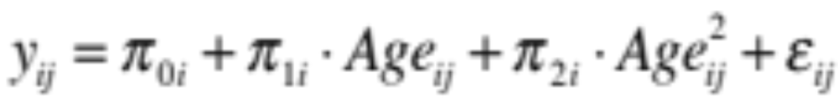
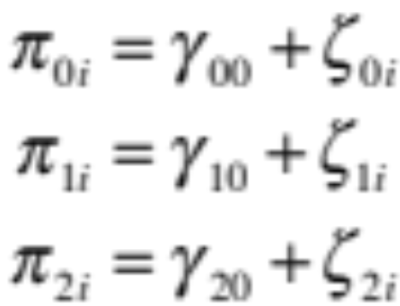
Multilevel model
General model formulation
Level-1
Level-2
Random effects
(not necessary to include all)
Fixed effects

Slide 7
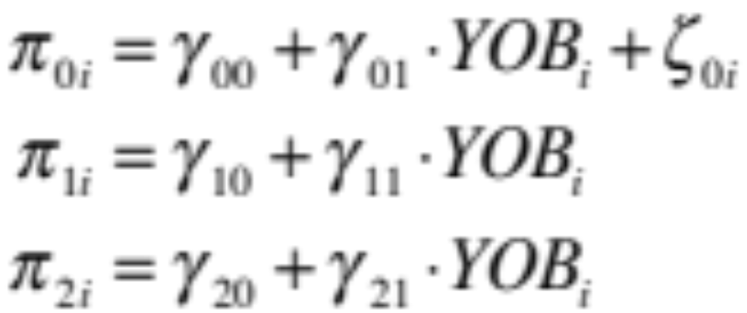
Incorporate cohort effects
Incorporate cohort effects
  YOB (time-invariant)
  or
  CY (time-variant)

Slide 8
Composite model formulation
(only the fixed effects are displayed)
We used the model to analyze the following risk factors:
  Body mass index (BMI)
  Waist circumference (WC)
  Systolic blood pressure (SBP)
  Diastolic blood pressure (DBP)
  Total cholesterol (TC)
  High-density lipoprotein (HDL)

Slide 9
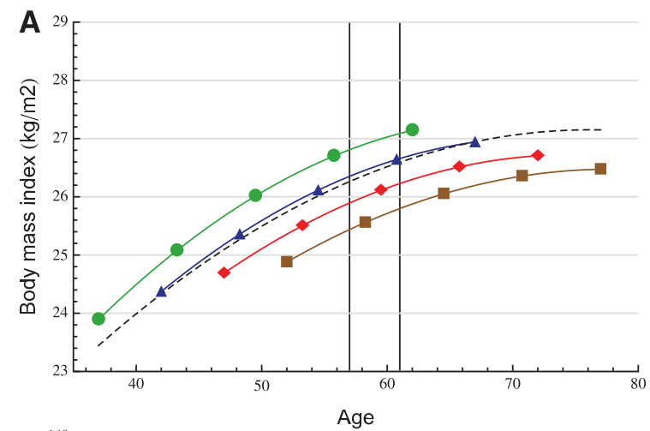
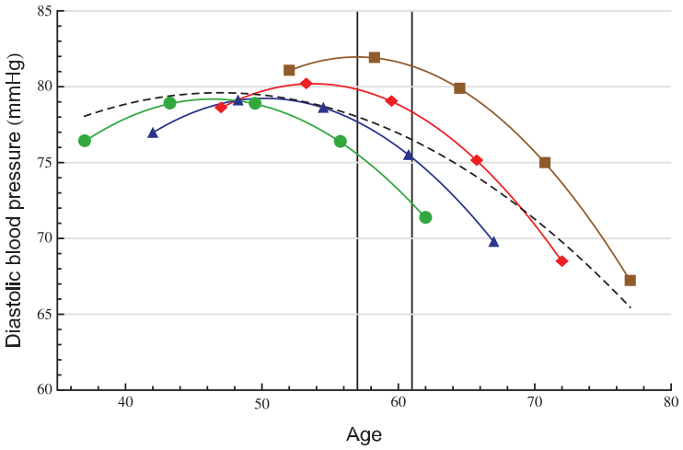
BMI and DBP (men)
BMI and DBP as a function of Age (and YOB)
Birth cohort: 1933 (n), 1938 (u), 1943 (▲), 1948 (l) and unadjusted for YOB (---)
Results for other variables stratified by sex in:
Hulmán et al., Int J Epidemiol 2014;doi:10.1093/ije/dyt279

Slide 10
Multilevel models - summary
Flexibility (number of measures, missing data)
Interpretation is similar to OLS regression
Availability of software packages (e.g. R: lme4)
Focus on the mean
Assumptions (normality)

Slide 11
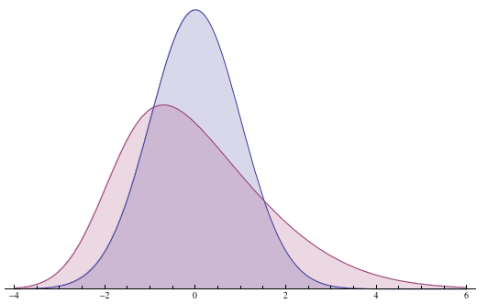
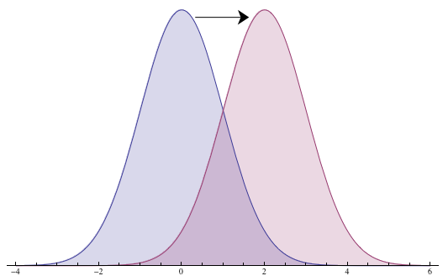
Change from a different aspect
Limitation of regression models focusing on the mean
More results on BMI, but limited evidence on other risk factors

Slide 12
Aim (2)
To characterize the change of distributions
Notes:
Mention age…

Slide 13
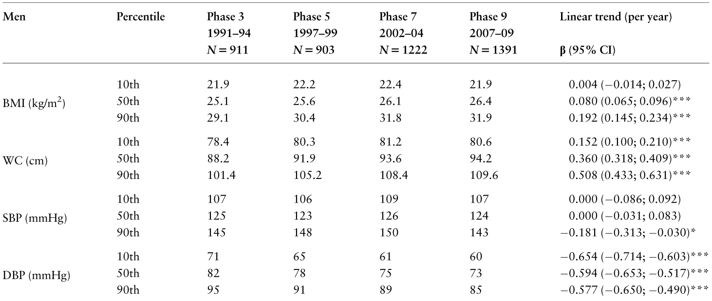
Sequential cross-sectional analysis (WH II)
Age-group: 57-61
Percentiles + Linear trend (quantile regression)
*** P<0.001
Source: Hulmán et al., Int J Epidemiol 2014;doi:10.1093/ije/dyt279
Table 3, page 5

Slide 14
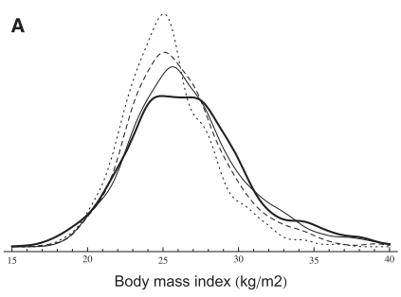
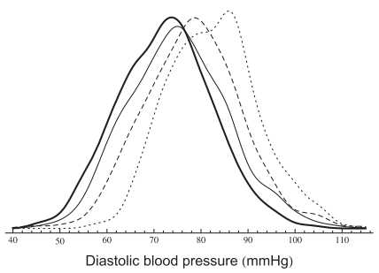
Sequential cross-sectional analysis
Density plots (PDF of smooth kernel distribution)
Phases: 3 (dotted), 5 (dashed), 7 (solid), 9 (thick)
Source: Hulmán et al., Int J Epidemiol 2014;doi:10.1093/ije/dyt279
Figure 1, page 6

Slide 15
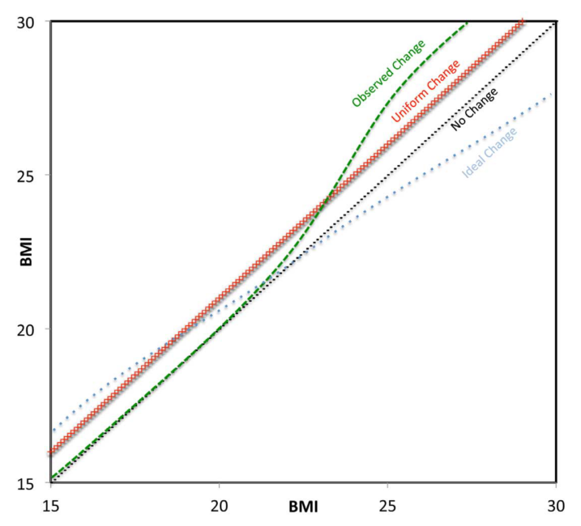
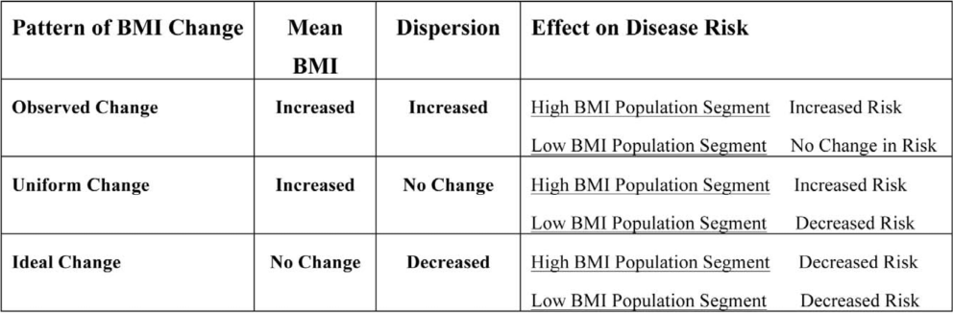
BMI (Razak et al.)
Low- and middle income countries
1991-2008
732,784 women from 37 countries
Source: Razak et al., PLOS Med 2013; 10(1): e1001367.
Figure 4, page 11 (doi:10.1371/journal.pmed.1001367.g004)

Slide 16
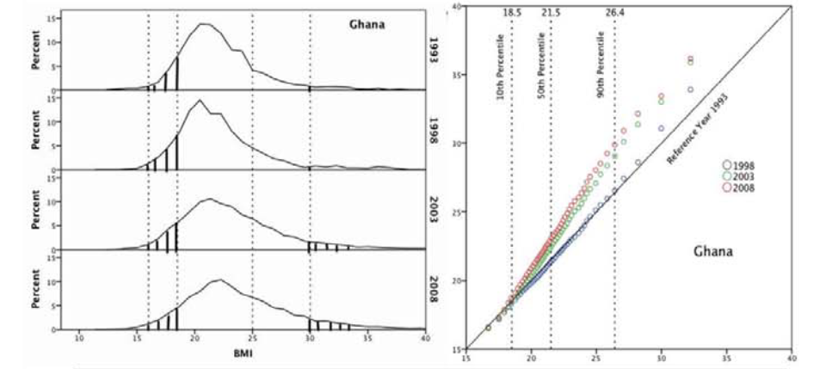
BMI (Razak et al.)
Source: Razak et al., PLOS Med 2013; 10(1): e1001367.
Figure 3, page 9 (doi:10.1371/journal.pmed.1001367.g003)

Slide 17
BMI (Bottai et al.)
Aerobics Center Longitudinal Study
1970-2006
74,473 BMI repeated measures from 17,759 men with ≥ 2 visits
Stratified by physical activity (PA)

Slide 18
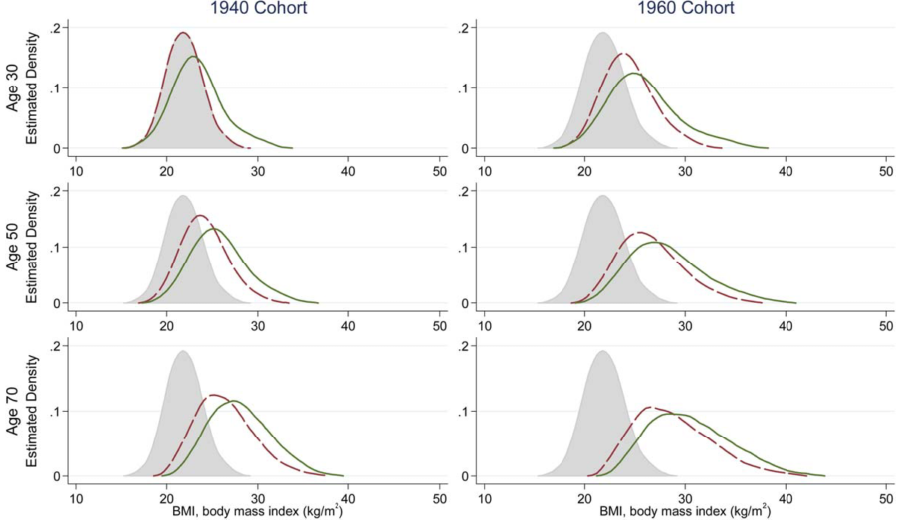
BMI (Bottai et al.)
PA:
active (dashed)
Inactive (solid)
Source: Bottai et al., Obesity 2013; doi:10.1002/oby.20618.
Figure 2, page 5

Slide 19
Summary and conclusions
Cohort effects should be considered when analyzing change over a long period of time
Adjustment for continuous variables
Methods beyond mean regression
  Visualization (QQ and density plot)
  Quantile regression

Slide 20
References
Singer JD, Willett JB, Applied longitudinal data analysis: modeling change and event occurrence
Oxford University Press 2003, ISBN-13 978-0-19-515296-8
Hulmán A, Tabák AG, Nyári TA, et al., Effect of secular trends on age-related trajectories of cardiovascular risk factors: the Whitehall II longitudinal study
Int J Epidemiol 2014;doi:10.1093/ije/dyt279
Razak F, Corsi DJ, Subramanian SV, Change in the body mass index distribution for women: analysis of surveys from 37 low- and middle-income countries
PLOS Med 2013; 10(1): e1001367.
Bottai M, Frongillo EA, Sui X, et al., Use of quantile regression to investigate the longitudinal association between physical activity and body mass index
Obesity 2013;doi:10.1002/oby.20618

Slide 21






Acknowledgments
The Leadership in Epidemiological Analysis of longitudinal Diabetes-related data (LEAD) Consortium

Slide 22
Thank you for your attention!

